Slide 1
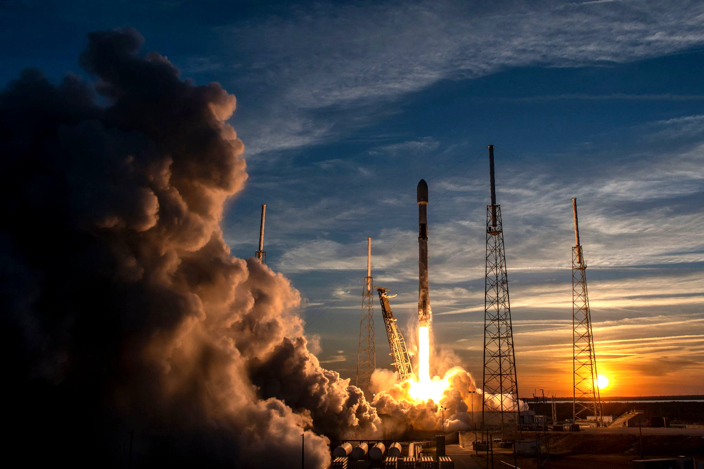

Winning Space Race with Data Science
Ana Hemani
02/04/2025

Slide 2
Outline
Executive Summary
Introduction
Methodology
Results
Conclusion
Appendix

Slide 3
Executive Summary
Summary of methodologies
Data Collection with API
Data Collection with Web Scraping
Data Wrangling
Exploratory Data Analysis with SQL
Exploratory Data Analysis with Data Visualization
Interactive Visual Analytics with Folium
Machine Learning Prediction
Summary of all results
Exploratory Data Analysis result
Interactive analytics in screenshots
Predictive Analytics result

Slide 4
Introduction
Project background and context
SpaceX advertises Falcon 9 rocket launches on its website at a cost of $62 million, whereas other providers charge upwards of $165 million per launch. A significant portion of these savings comes from SpaceX's ability to reuse the first stage of the rocket. Therefore, predicting whether the first stage will successfully land can help determine the cost of a launch. This information is valuable for alternative companies looking to compete with SpaceX in the rocket launch market. The objective of this project is to develop a machine learning pipeline that predicts the successful landing of the first stage.
Problems you want to find answers to
What factors influence the successful landing of a rocket?
The interplay of various features contributes to the likelihood of a successful landing.
What operating conditions must be met to ensure a reliable landing program?

Slide 5
Section 1
Methodology

Slide 6
Methodology
Executive Summary
Data collection methodology:
Data was collected using SpaceX API and web scraping from Wikipedia.
Perform data wrangling
One-hot encoding was applied to categorical features
Perform exploratory data analysis (EDA) using visualization and SQL
Perform interactive visual analytics using Folium and Plotly Dash
Perform predictive analysis using classification models
How to build, tune, evaluate classification models

Slide 7
Data Collection
Data was collected using numerous methods
Data collection was obtained using get request to the SpaceX API.
The response content was then decoded as a Json using .json() function call and then moved to Pandas dataframe using.json_normalized().
Data was then cleaned, checked for missing values, and filled in missing values as needed.
Next, we executed web scraping from Wikipedia for Falcon 9 launch records via BeautifulSoup.
Lastly, the objective was to extract the launch records as a HTML table, parse the table, and then convert it into a Pandas dataframe for future analysis.

Slide 8
Data Collection - SpaceX API
Used the GET request to the SpaceX API to obtain data
Cleaned the requested data
Sorted out some basic data wrangling and formatting

Slide 9
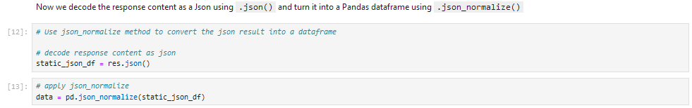
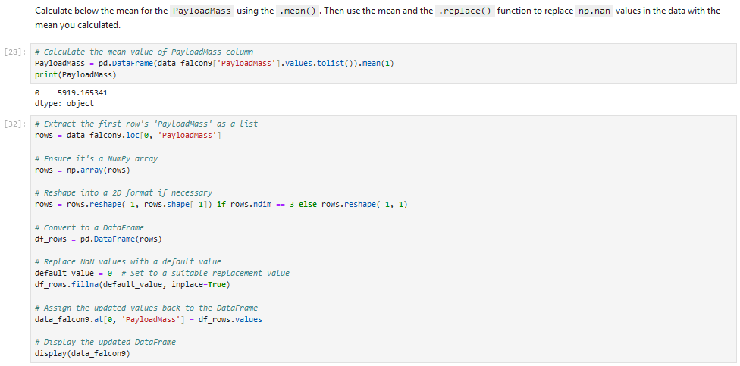

Slide 10
Data Collection - Scraping
Applied web scraping to web scrap Falcon 9 launch records via BeautifulSoup
Parsed the table
Converted the table into a Panda dataframe

Slide 11
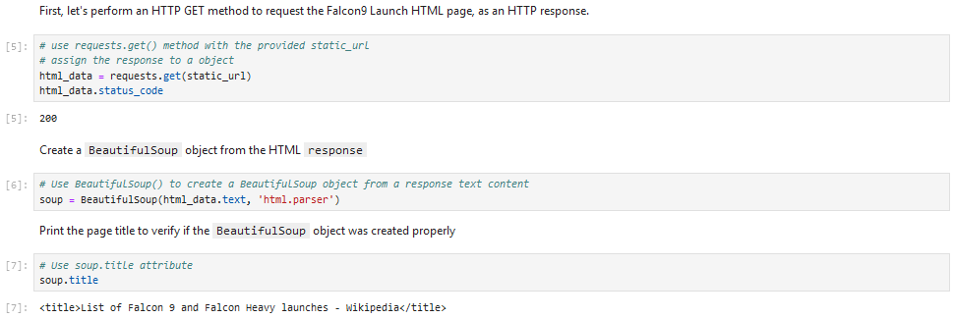
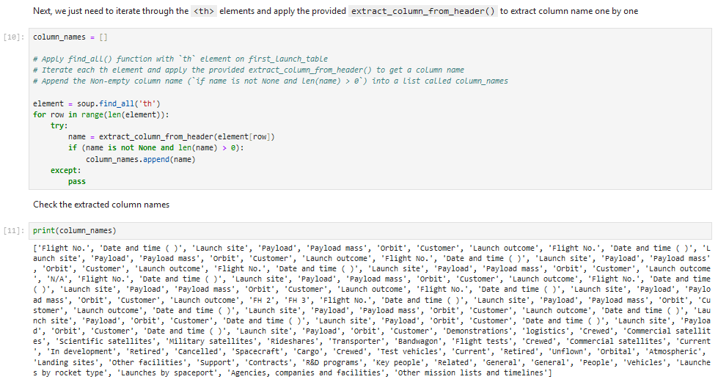

Slide 12

Data Wrangling
Executed exploratory data analysis
Defined the training labels
Calculated the number of launches at each site and the number and occurrence of each orbit
Created landing outcome label from outcome column
Exported the results to CSV

Slide 13
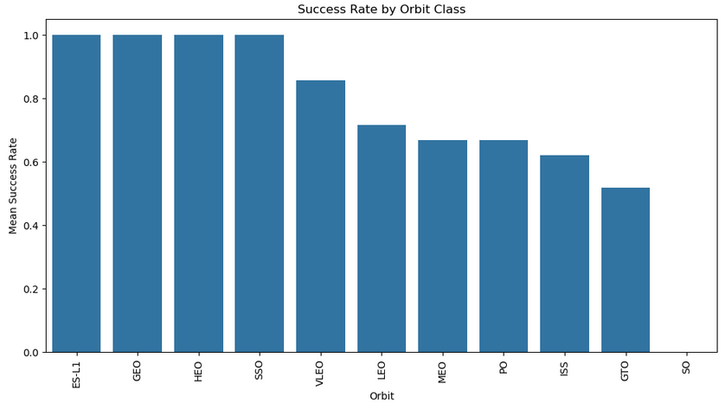
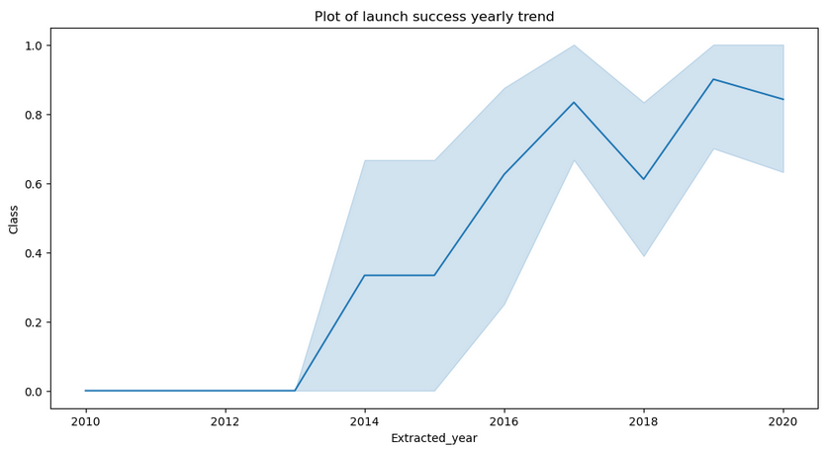
EDA with Data Visualization
Explored the data via envisioning the relationship between
Flight number and launch site
Payload and site
Success rate of each orbit type
Flight number and orbit type
The launch success yearly trend

Slide 14
EDA with SQL
Loaded the SpaceX dataset into a PostgreSQL database without existing the Jupyter Notebook
Applied EDA via SQL to gain insight from the data
Wrote queries to find the following instances:
Names of the unique launch sites in the space mission
Total payload mass carried by boosters launched by NASA (CRS)
Average payload mass carried by booster version F9 v 1.1
Total number of successful and failed mission outcomes
Failed landing outcomes in drone ship, booster version, and launch the site names.

Slide 15
Build an Interactive Map with Folium
Marked all launch sites
Added map objects such as markers, circles, lines to mark the success or failure of launches for each site on the folium map
Assigned the feature launch outcomes (success/failure) to class 0 and 1
I.e., 0 = failure and 1 = success
Per the color-labeled marker clusters
Identified which launch sites have relatively high success rate
Calculated the distances between a launch site to its proximities
Answered some questions:
Are launch sites near railways, highways, and coastlines?
Do launch sites keep certain distance away from cities?

Slide 16
Build a Dashboard with Plotly Dash
Built an interactive dashboard via Plotly Dash
Plotted pie charts showing the total launches by a certain site
Plot scatter graph indicating the relationship with Outcome and Payload Mass (kg) for the different booster version

Slide 17
Predictive Analysis (Classification)
Loaded the data via NumPy and Pandas
Transformed the data
Split data into training and testing
Built various machine learning models and tuned different hyperparameters via GridSearchCV
Used accuracy as the metric for the model
Improved the model using feature engineering and algorithm tuning
Established the best performing classification model

Slide 18
Results
Exploratory data analysis results
Interactive analytics demo in screenshots
Predictive analysis results

Slide 19
Section 2
Insights drawn from EDA

Slide 20
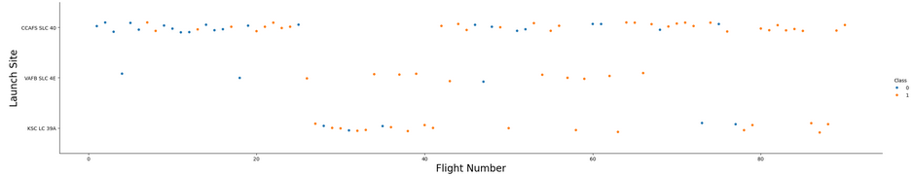
Flight Number v Launch Site
Found that the larger the flight amount at a launch site, the greater the success rate

Slide 21
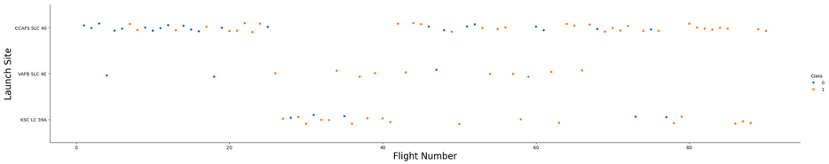
Payload v Launch Site
Greater the payload mass for launch site CCAFS SLC 40, the higher the success rate for the rocket

Slide 22

Success Rate v Orbit Type
ES-L 1, GEO, HEO, SSO, VLEO had the most success rates

Slide 23
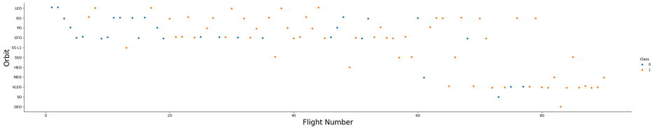
Flight Number v Orbit Type
Observed in the LEO orbit, success is related to the number of flights
GTO orbit shows no relationship between flight number and the orbit

Slide 24
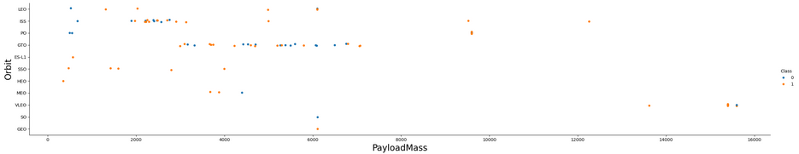
Payload v Orbit Type
Observed the successful landing are more for PO, LEO, ISS orbits

Slide 25
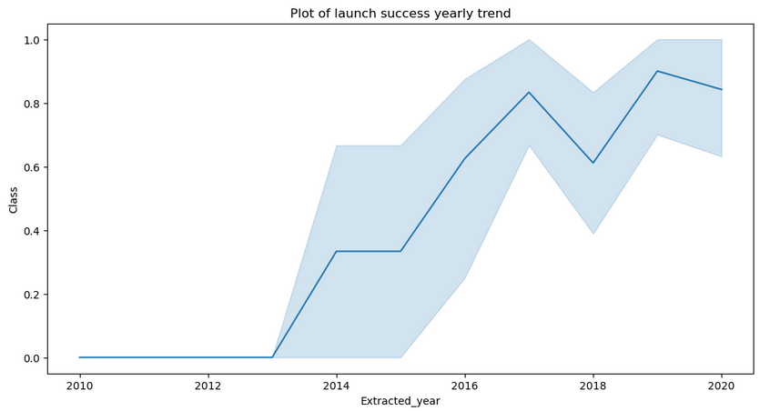
Launch Success Yearly Trend
Success rate since 2013 continued to increase until 2020

Slide 26
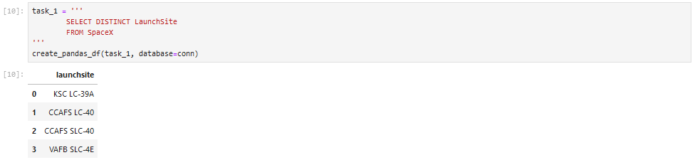
All Launch Site Names
Used the keyword DISTINCT to display only distinctive launch sites from the SpaceX data

Slide 27
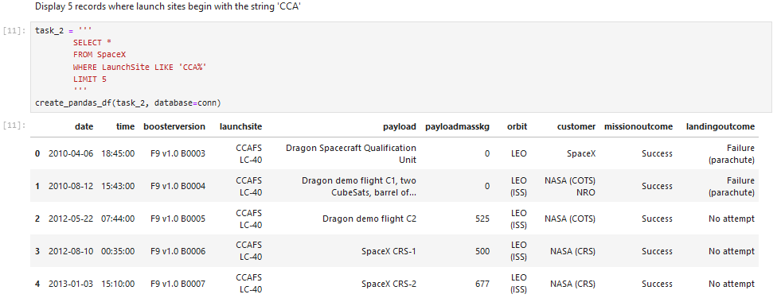
Launch Site Names Begin with ‘CCA’
Displayed 5 records where launch sites start with ‘CCA’

Slide 28
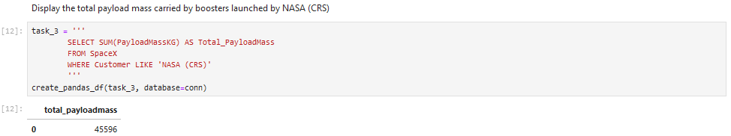
Total Payload Mass
Calculated the total payload carried by boosters from NASA as 45596

Slide 29
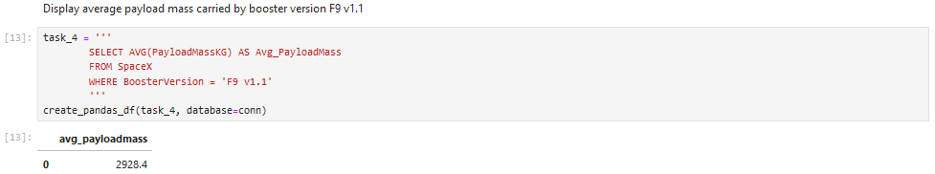
Average Payload Mass by F9 v 1.1
Calculated the average payload mass carried by booster version F9 v 1.1 as 2928.4

Slide 30
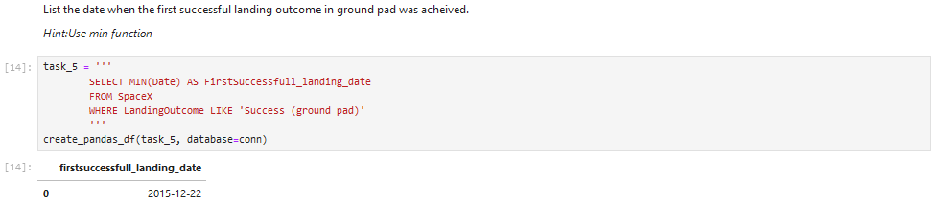
First Successful Ground Landing Date
Observed that the dates of the first successful landing outcome on ground pad was December 22, 2015

Slide 31
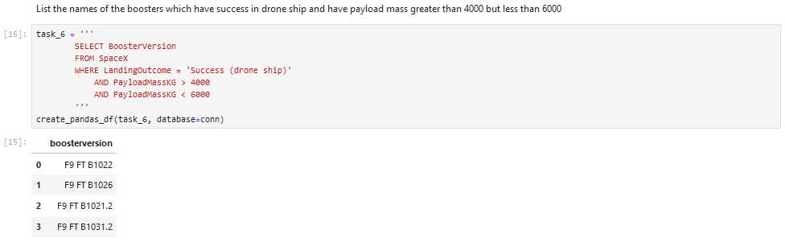
Successful Drone Ship Landing with Payload between 4000 and 6000
Used the WHERE clause to sift for boosters which have positively landed on drone ship
Applied the AND condition to define successful landing with payload mass more than 4000 but less than 6000

Slide 32
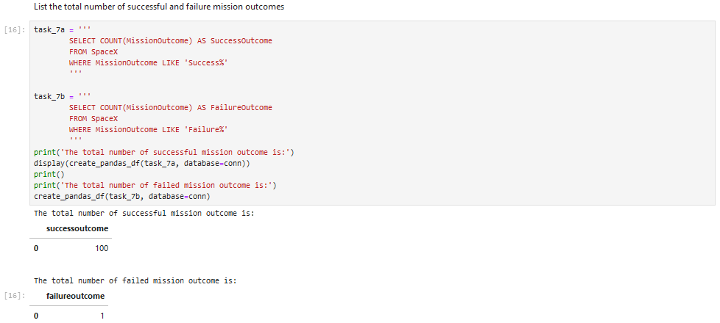
Total Number of Successful and Failure Mission Outcomes
Used wildcard like ‘%’ to sift for WHERE MissionOutcome was a success or failure

Slide 33
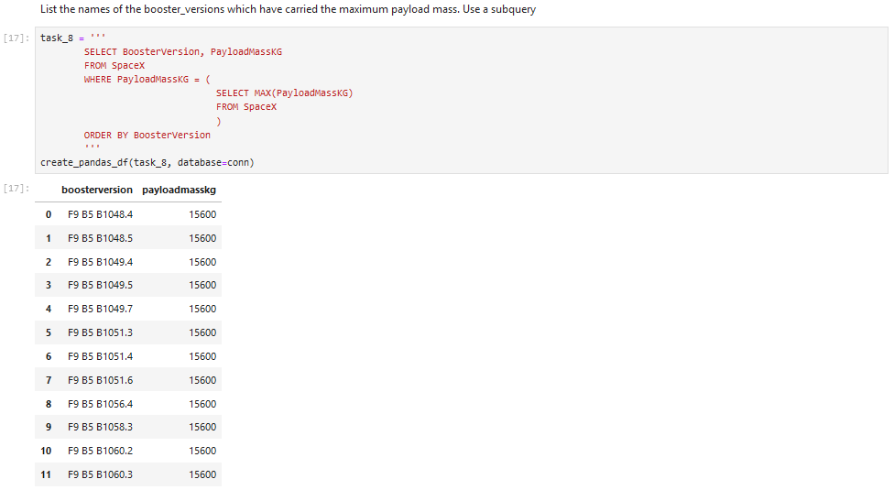
Boosters Carried Maximum Payload
Defined the booster which has carried the maximum payload using a subquery in the WHERE clause and the MAX () function

Slide 34
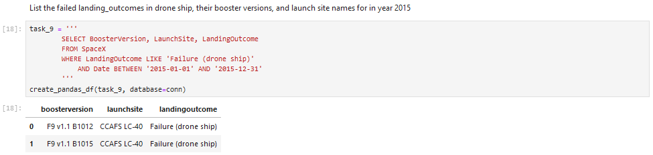
2015 Launch Records
Used a combination of the WHERE clause, LIKE, AND, and BETWEEN condition to sift for negative landing outcomes in drone ship, their booster versions, and launch sites names for 2015

Slide 35
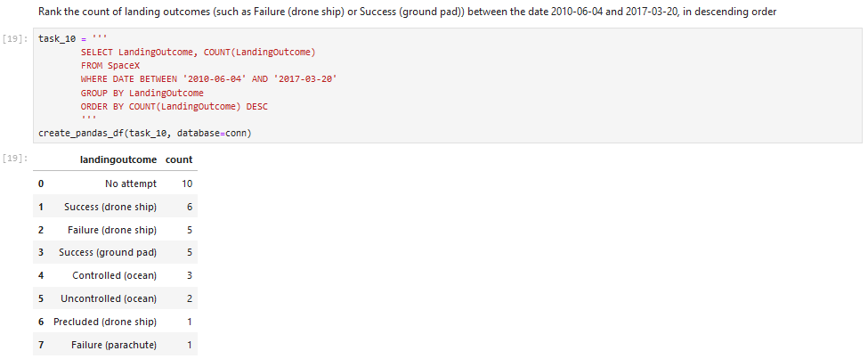
Rank Landing Outcomes Between 06/10/2010 and 03/20/2017
Selected landing outcomes, the COUNT of landing outcomes from the data, and used the WHERE clause to sift for landing outcomes BETWEEN 06/04/2010 to 03/20/2010
Applied the GROUP BY clause to group the landing outcomes and the ORDER BY clause to order the grouped landing outcomes in descending order

Slide 36
Section 3
Launch Sites Proximities Analysis

Slide 37

All launch sites globally

Slide 38

Markers indicating launch sites with colored labels

Slide 39

Launch sites distance to landmarks

Slide 40
Section 4
Build a Dashboard with Plotly Dash

Slide 41

Pie chart indicating the success % achieved by each launch site

Slide 42

Pie chart indicating the launch site with the most launch success ratio

Slide 43
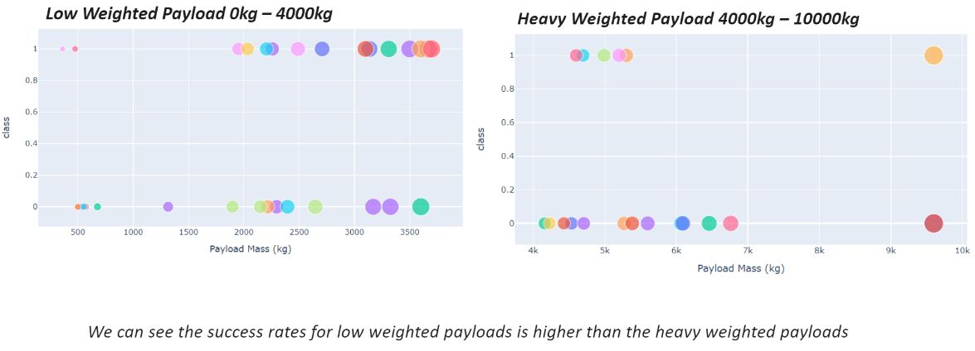
Scatter plot of Payload v Launch Outcome for all sites with various payload designated in the range slider

Slide 44
Section 5
Predictive Analysis (Classification)

Slide 45
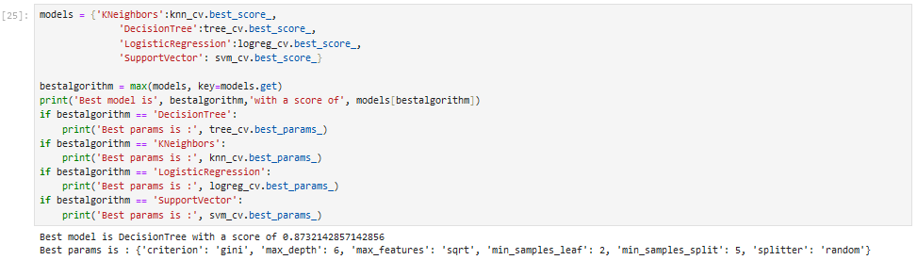
Classification Accuracy

Slide 46
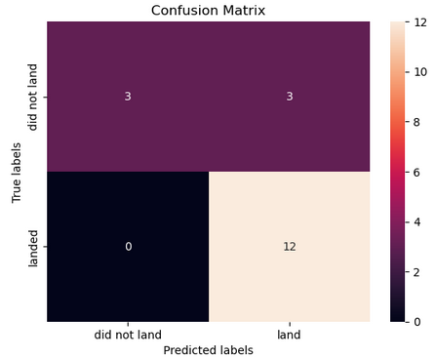
Confusion Matrix
Decision tree classifier indicates that the classifier can distinguish between the different classes
The major problem is the false positives
I.e., unsuccessful landing marked as successful landing by the classifier

Slide 47
Conclusions
The larger the flight amount as a launch site, the bigger the success rate at a launch site
Launch success rate started to rise in 2013 until 2020
Orbits ES-1, GEO, HEO, SSO, VLEO has the most success rate
KSC LC-39A has the most successful launch of any sites
Decision tree classifier is the finest machine learning algorithm for this task

